Slide 1
Anti-counterfeiting and Brand Protection
Pic source / credit - https://snapdragon-ip.com/world-anti-counterfeiting-day-2018-five-reasons-not-to-buy-counterfeits/

Slide 2
Counterfeiting:
Manufacturing and offering for sale a product using the brand of a third party without their authorisation.
Generally made from lower quality components;
Attempt to sell cheap imitation of brands consumers know and trust;
Consumers may be led to purchase believing it to be legitimate
Brand protection:
The process and set of actions - a right holder undertakes:
to prevent third parties from using its intellectual property without permission
this may cause loss of revenue and,
destroys brand equity, reputation and trust.

Slide 3
Source - “The State of Counterfeiting In India – 2020- - A report by The Authentication Solution Providers’ Association (ASPA)
Globally - counterfeiting stands around 3 percent of global trade;
According to one OECD-EUIPO report, international trade in counterfeit pharmaceuticals reached $4.4 billion in 2016
India Story:
Counterfeit incidents increased by 24 percent between 2018 to 2019
Top 10 sectors - currency, FMCG, alcohol, pharmaceutical, documents, agriculture, infrastructure, automotive, tobacco, lifestyle and apparel
FMCG sector most impacted– incidents increased by 63 percent between 2018 (79) to 2019 (129)
Not limited to high-end luxury items but common day to day items including cooking oil, ghee, hair oil, soaps and medicine are increasingly reported

Slide 4
Counterfeiting during CoVID19
Even in the Covid-19 crisis, it has been observed that :
Criminals taking advantage of high market demand for personal protection and hygiene products;
Between February to April 2020, more than 150+ cases of counterfeit incidents had been reported including fake PPE kits, sanitizers, and masks.
Other key targets - Pharmaceuticals, medical supplies, FMCG, tobacco & alcohol, which criminals frequently singled out before the pandemic
Closures of businesses and disruptions in transportation led to distortions in supply chains.
Criminals took these as opportunity to make illicit profits
Reacted quickly to the crisis and have adapted their strategies

Slide 5
Officials have highlighted a recent sharp increase in seizures of fake cigarettes, including seizures of containers filled with illicit cigarettes.. ,
the evidence also points to strong growth in the trade and production of illicit alcohol, wine.
Demand for alcohol has remained relatively stable throughout the pandemic.
This gap between demand and supply is exploited by criminals who continue to supply counterfeit alcohol that is often substandard.
Enforcement officials reported the forging of labels or production of inferior quality wine.
Emergence of new routes for illicit trade, a boom in online environment and growth in counterfeiting
Though too early to conclude the overall effect the pandemic on the illicit trade in fake goods.

Slide 6
Online Counterfeiting
Selling by third-party unvetted vendors from all over the world
easy access to millions of potential customers
Study by the US Government Accountability Office in 2018 - about 40 percent of samples bought on popular e-commerce websites were fake.
Counterfeit in underground grey markets for a mere fraction of the price of an authentic product,
Whereas on popular e-commerce marketplaces, consumers presume they buying authentic at almost full price, but instead, are duped into purchasing counterfeit goods
Consumers compromising personal information
Now, e-commerce has become the ‘general store’ for everyone’s needs,
Shoppers may not even aware of seller’s identity or whether goods they are buying are genuine
Even photographs of goods on websites are often stolen from the brand owner’s website.
Counterfeiters can also easily and anonymously accept credit card transactions from across the globe and later use consumers’ collected data to commit identity theft.
Protecting consumers from online fraud has been challenging.

Slide 7
Growth in Online Counterfeiting Factors & Challenges
Factors influencing product rankings
Lack of redress for account suspensions, de-listings
Non review /revision of Policies to minimize infringements
Lack of transparency / cumbersome process of disputes resolution
Marketplace operators need to take concrete steps to vet:
the supply chains,
the suppliers
authenticity of their products

Slide 8
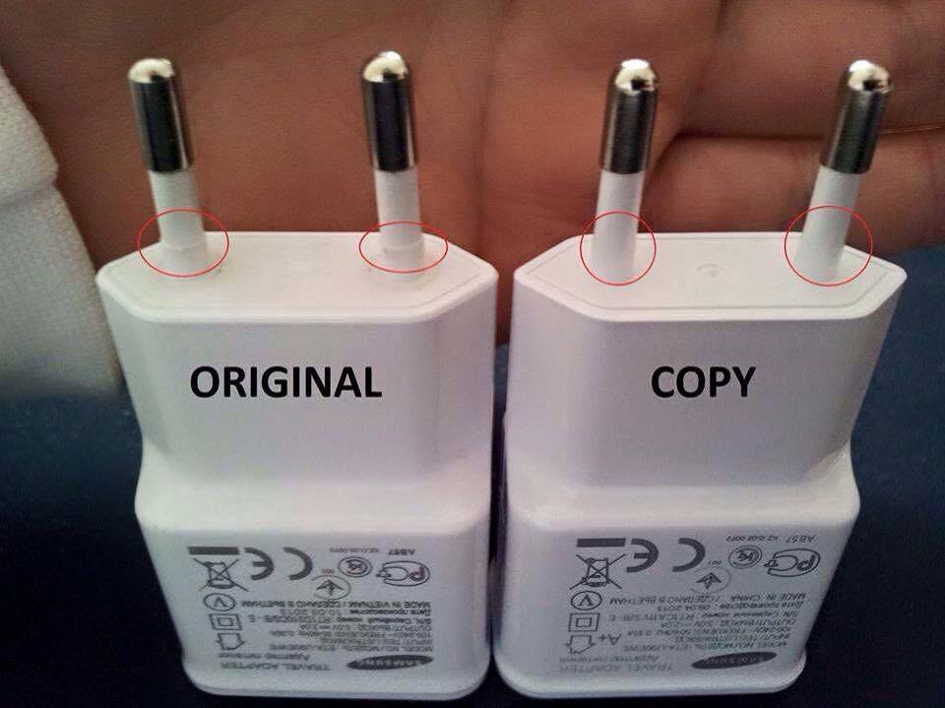

Slide 9
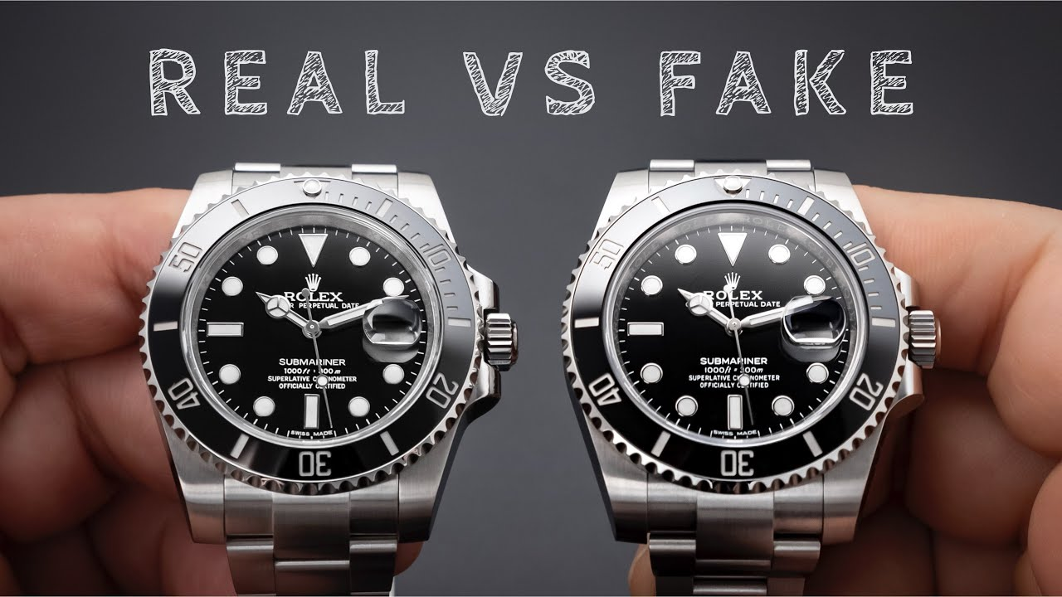
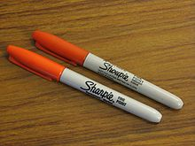
Picture credit – Wikipedia (Counterfeit)

Slide 10
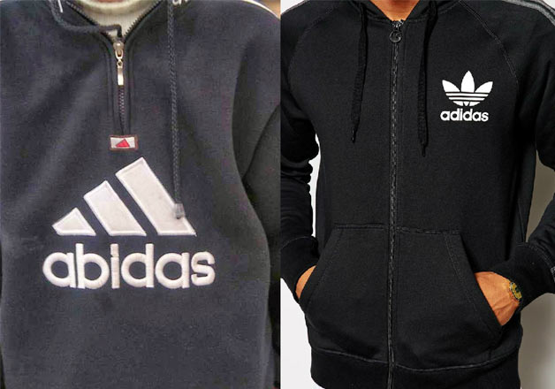

Slide 11
Threats
Organized crimes, drug trafficking, terrorisms
do not pay taxes;
employ child labor;
steal your identity.
health and safety of consumers
hurt innovative businesses
smaller companies may be out of business
more than 4 million jobs are lost due to counterfeit industry
Growth factors
e-commerce centric world
free trade agreements
highly profitable
Consumers attitude towards luxury goods no matter what
Unawareness among consumers
Buying Counterfeit is not illegal

Slide 12
Case Study – HP India (source - the free press journal)
Counterfeit goods of $6 million seized by authorities- Nov’19-Jul’20
10,000 websites de-listed, 78 raids, 68 arrests
Co-operated enforcement agencies to conduct raids
Counterfeiters moved to online platforms due to COVID-19 lockdowns
HP - ACF programme works closely with major e-commerce platforms to only allow authorised partners to sell genuine products
Counterfeit ink and toner print supplies pose a serious threat
Single raid on a syndicate in Mumbai – seizures of $3 million
Protection Service - Customer Delivery Inspection (CDI) and also reporting online on the HP website

Slide 13
BRAND PROTECTION
STRATEGIES

Slide 14
Strategy for Beginners
Meet legal requirements
Register your brands’ names and logos
Gather evidence for enforcement
burden falls on right holders to prove that its IP is being infringed
Most common evidence required for social media platforms:
Photos
Videos
Captions
Comments
Most common evidence required for marketplaces:
Screenshot or link to the infringing listings
location of infringing listing material on said platform
Description of item, including details such as ID number, price, and seller details
Can’t report without the above information

Slide 15
After collecting necessary information - comply with each platform’s individual reporting requirements and register IP there.
All major marketplaces such as Alibaba, Amazon and eBay all have different methods for registering IP.
Amazon has
https://brandservices.amazon.com/brandregistry
https://brandservices.amazon.com/projectzero
https://brandservices.amazon.com/counterfeitcrimesunit
After sending a takedown request - check up on the status daily basis
multi-channel monitoring
consider own target market and geographic focus.
List to identify official sellers vs repeat infringers
Monitor new counterfeit indicators trends, and understand patterns counterfeiters are following
Hire a dedicated staff to gather information and send removal requests
Make Process to centralize all this information

Slide 16
Educate key stakeholders within organisation across Sales, Marketing, Digital, Legal, Manufacturing, Supply Chain, and Finance departments so they can enjoy the benefits and outcomes of a strong brand protection strategy.
External stakeholders
Teach the customers to spot fakes
Key to educating consumers about counterfeiting is to highlight aspects of the product that are the most difficult for counterfeiters to copy perfectly.
Education about the harms of counterfeiting
Move into business intelligence gathering mode
Integrate online and offline brand protection efforts
combination of online and offline tools is a solid Brand Protection strategy
Adopting a proactive approach
helps brands excel in the fight against fakes.
helps brands have carry out more impactful and long-lasting actions when it comes to fighting counterfeiters.

Slide 17
In 2020 Review of Notorious Markets for Counterfeiting and Piracy published by the Office of the United States Trade Representative, an Indian website was cited in the list of the most notorious online platforms for sales of counterfeit products.
Several famous markets in Mumbai, Kolkata and New Delhi were also included in the list of physical markets that were notorious for sales of counterfeit goods.
For example, Heera Panna Market in Mumbai was reported to be a hub for high-quality counterfeit watches, footwear, apparel, accessories and cosmetics.
The review also reports that conducting enforcement actions at those locations is expensive and challenging, as is ensuring the effectiveness of raids.

Slide 18
https://www.incoproip.com/case-studies/brother-places-its-customers-first-with-brand-protection/
https://www.incoproip.com/case-studies/how-mondelez-international-puts-consumer-trust-at-the-heart-of-brand-protection/

Slide 19
Image courtesy :https://www.google.com/imgres?imgurl=https%3A%2F%2Fswaritadvisors.com%2Fblog%2Fwp-content%2Fuploads%2F2021%2F12%2FStarbucks-vs.-Sardarbuksh.jpg&imgrefurl=https%3A%2F%2Fswaritadvisors.com%2Fblog%2Ftrademark-dispute-between-starbucks-vs-sardarbuksh%2F&tbnid=BG6kubpAfoFlFM&vet=12ahUKEwiHvYHP0K39AhVmlNgFHZCgD1QQMyhPegQIARB3..i&docid=Wfu08ZfhWjsh0M&w=670&h=352&q=latest%20brand%20protection%20case%20study&ved=2ahUKEwiHvYHP0K39AhVmlNgFHZCgD1QQMyhPegQIARB3

Slide 20
Preventative measures / technology
Radio frequency identification, microscopic tags, bar-coding, licence databases, unique identity codes or holograms and seals of authenticity
use of multiple features helps in establishing infringement before courts and authorities, since most counterfeits still fail to comply with all the features.
Investigation & enforcement / Legal Action
To a large extent, the effectiveness of an anti-counterfeiting action depends on the prior investigation
Don’t rely solely on the investigators for both the investigation and legal action, without consulting lawyers
While the initial role of the investigator is crucial for proper target identification, legal action should always be initiated with the involvement of local lawyers specialised in IP litigation.
An investigator’s interest usually ends once a raid is conducted, while the case before the courts continues and may result in adverse orders if not properly pursued.

Slide 21
Take proactive action
Counterfeiters more successful when left unchallenged;
shift their energies to more passive targets when fight back.
Once realised aggressive action is best strategy
Set priorities. Identify the biggest offenders, offering the greatest number of counterfeit goods in the most highly trafficked venues, and address them first.
Brand owners should determine which counterfeit goods are generating the largest sales, and target them first as well.
Monitor points of promotion
While it’s important to identify and shut down distribution channels, it’s almost certain that counterfeiters will regularly seek new sales venues
Critical to monitor the online promotional channels used
Counterfeiters use the same effective promotion techniques employed by legitimate marketers
Using paid search advertising, links within social media, cybersquatting and spam, they successfully steer traffic to their illicit offerings
Monitoring for these promotional efforts is critical

Slide 22
Fight online counterfeit sales holistically
Online counterfeit sales are easier to address when the entire enterprise participates.
set up a cross-functional task force to address the issue in a coordinated, holistic manner.
vary by industry and enterprise, but can include legal, marketing, risk management, loss prevention
Attack both promotional and distribution channels, this group needs to address more features of the problem than seen in the physical world
Set priorities and strategies for detecting, reporting and responding to infringers and inform the process as per situations.

Slide 23
Use online intelligence for offline measures
Physical investigations, raids, other activities being costly and time-consuming, it’s critical to know the focus area.
Online intelligence can help identify the most wanted targets to be focused and most effective.
Act swiftly and globally
While a domestic target seem easy but it’s more effective to launch global action
Ensuring your trademarks are registered internationally some countries observe a “first-to-file” policy
Global effort doesn’t prevent targeting a specific country exclusively., this may require competent language translation resources for monitoring, detection and enforcement.
Try to hire third-party brand protection solution providers for expertise.
Educate your customers
Educate your customers about the risks of buying from unauthorized sources, and take their help in reporting targets.
Artificial intelligence and machine learning
Use AI to understand the pattern, the way they describe products with keywords and continually change search parameters to adapt.

Slide 24
Legal / Enforcement actions IN INDIA
Enforcement
District court and above can hear trademark disputes related to passing off and infringement.
Therefore, a case relating to a trademark dispute can usually be filed in a district court.
Actions
The actions which can be taken to protect trademarks in India, including against passing off and infringement, are as follows.
Civil remedies :
an interlocutory, temporary or ad interim injunction;
a permanent or perpetual injunction;
damages or accounts of profits; and
delivery up and destruction

Slide 25
A registered owner of a trademark or a licensee (provided that the licensee agreements grants such right) which believes that its mark is being infringed may institute infringement proceedings.
Injunctions:
Under the Code of Civil Procedure 1908, a temporary injunction can be granted by the court where one of the following applies:
The property in dispute is in danger of being wasted, damaged or alienated by any party to the suit, or wrongfully sold in execution of a decree.
The defendants threatens or intends to remove or dispose of the property with a view to defrauding creditors.
The defendant threatens to cause injury to the plaintiff in relation to any property in dispute in the suit.
The defendant is about to commit a breach of contract or other kind of injury.
The court is of the opinion that the interests of justice require a temporary injunction.

Slide 26
Punitive damages may be allowed at the discretion of the court.
In Time Incorporated v Lokesh Srivastava (2005 (3) PTC (3)) the court observed that the award of compensatory damages to the plaintiff is intended to compensate it for the loss suffered, whereas punitive damages are intended to deter the wrongdoer.
As such, in appropriate cases these must be awarded to signal to wrongdoers that the law does not consider a breach to be merely a matter between rival parties, but is also concerned about those which suffer on account of the breach.
In Cartier International Ag v Gaurav Bhatia (CS (OS) No 1317/2014) the plaintiff submitted a methodology for computing punitive damages. The Delhi High Court granted damages of Rs10 million after taking into consideration the methodology of computing punitive damages as stated by the plaintiff.

Slide 27
Customs enforcement
The IP Rights (Imported Goods) Enforcement Rules 2007 empower customs officers to enforce IP rights over imported goods.
Detailed procedure by which a rights holder can register its IP rights with customs officials.
This registration imposes an administrative duty on Customs to protect the rights holder against violation of its IP rights.
Appeal - infringement decisions
An appeal from an original district court judgment goes to the relevant high court.
An appeal from an original judgment or decree of a single bench of the high court (with original jurisdiction) goes to the division bench of the high court as a regular first appeal.
A judgment or decree in a regular first appeal can be challenged as a special leave petition before the Supreme Court.
Once a special leave petition has been admitted by the Supreme Court, it is converted to an appeal.

Slide 28
Criminal Remedies
Sec. 103 / 104 – Trade Marks Act, 1999
Sec. 63 and 64 – Copyright Act, 1957
Falsification of Trademarks / Infringement of copyright is a cognizable offence
A complaint may be filed before a Magistrate; or
Police can register an FIR and prosecute directly;
Registration is not a requirement.
Imprisonment- 6 months to 3 years
Fine- Rs 50,000 to 2 lakhs
Enhanced penalty on subsequent convictions.
Seizure, forfeiture and destruction of infringing goods/ material for placing before the Magistrate

